Slide 1
Computer Science 131:
Programming with C# Part 7
Introduction to
Object Oriented Programming

Slide 2
Agenda
Classes and Objects
Class Members
Client Code
Constructors
Static Members

Slide 3
Skill Check! Procedural Programming
Create a new C# Console project.
Define a method that takes two integers as input arguments, and returns their sum.
From Main, call the method and pass two integer variables as arguments.
Print the two variables and their sum in a formatted string.
Bonus! Allow users to initialize the two integer variable values.

Slide 4
Object-Oriented Programming
Robust software development relies on a solid understanding of object-oriented techniques.
Encapsulation refers to the grouping of related logic and data members within a unit
This modular approach is helpful because it allows us to write code that is compartmentalized, easy-to-read, reuseable, and testable as a stand-alone component.

Slide 5
Encapsulation
Encapsulation is enabled through well-designed classes.
Classes are really blueprints that define a series of related methods and data structures.
The methods and data structures defined inside are referred to as members.

Slide 6
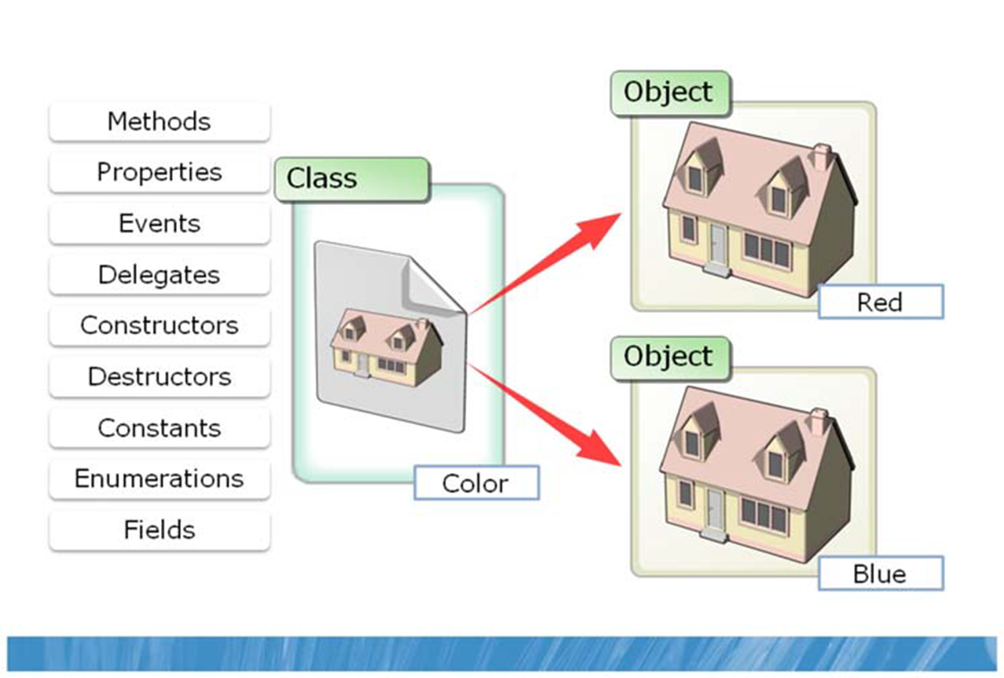
Encapsulation

Slide 7
Class Definitions
Classes definitions are like blueprints for how to create an object of that type.
class Employee
{
//class members go here
}
As long as we have access to a class definition, we can create an object of that type.

Slide 8
Class Members
Classes typically contain members
Fields (data members)
Methods
Properties
Events
Defining these program elements within a class structure gives them a relationship with other class member and is central to the concept of encapsulation.

Slide 9
Class Members: Fields
Classes can have field members, which are like variables declared within the class definition.
public class Employee
{
public string firstname;
public string lastname;
}

Slide 10
Class Members: Field and Method
The Animal class has two members, a field ‘Name’ and a method Talk()
class Animal
{
public string Name;
public string Talk()
{
return “Hello";
}
}

Slide 11
Accessibility
Varying levels of access can be assigned to the data members and methods of a class or struct to either hide internal logic and data or to grant access to specific structures.
Four common levels of access are private, internal, protected, and public.

Slide 12
Access Modifiers
public – visible from a client object
internal – visible within the assembly (EXE or DLL code)
private – visible within class
protected – same as private, but visible to derived classes
Internal is used by default if no access modifier is specified
public string firstname;
public string lastname;
private string title;
protected int EmpID;

Slide 13
Class Definition
Demonstration: Create a class definition

Slide 14
Objects
The class definition is referenced to generate objects of the class type.
Object instances are implementations of a class, and each instance stores a separate data set.
This creates a distinction between the class definition code, and the code that creates the objects. The latter is sometimes referred to as client code or driver code.

Slide 15
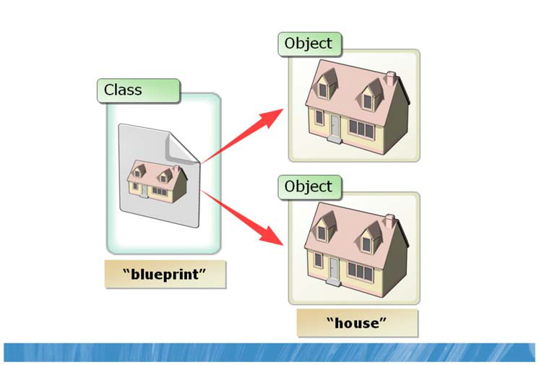
Classes and objects

Slide 16
Creating Objects
Creating an object is called instantiation. (Objects are sometimes called instances of a class).
The new keyword tells the computer to reserve space in memory for an object of this type and it’s members.
Animal myAnimal = new Animal();

Slide 17
Using Objects
Creating an object is called instantiation. (Objects are sometimes called instances of a class).
Once created, an object of the class type has access to the public members of the class:
myAnimal.name = "Sharpy";
myAnimal.Talk();

Slide 18
Class Methods
Methods are functions that are defined within a class definition, making them members of the class.
Public methods of the class are visible to objects.
class Employee
{
public DateTime getHireDate()
{
return this.hireDate;
}

Slide 19
Keyword This
The keyword this may be used to explicitly reference a member within the class-level scope from a method.
‘this’ is used to explicitly reference a peer member of the method’s class. It can be thought of as a placeholder for an object of that type.
return this.hireDate;

Slide 20
Using Object Methods
Object methods provide built-in functionality to the client code
DateTime hDate = employee165.getHireDate();

Slide 21
Classes and Objects
Demonstration: Creating Objects

Slide 22
OOP Challenge!
Create a new console application called Employee. Add an Employee class to the project.
Add two members to the class, a public field of type string called ‘Name’, and a public method called GetName() that prints the name value.
In Main(), create an object of type Employee. Assign a value to the Name field, and call the GetName method to display the name.

Slide 23
Constructors
Constructors are a special class method with the same name as the class and no return type.
public class Employee{
public Employee(string First, string Last)
{
firstname = First;
lastname = Last;
}
Constructors allow you to pass parameter arguments to initialize data members when you create an object in client code.

Slide 24
Creating an Object With Arguments
Declare an object of that type, using the ‘new’ keyword and pass in the values to match a class constructor method.
Employee emp1 = new Employee("Jana", "Milanova");
The only time the constructor method runs is at the point of instantiation.
The class definition must be available to the client code, either in the same namespace or through a ‘using’ directive.

Slide 25
Constructor Overloading
Defining multiple constructors with different sets of parameters allows clients to pass different combinations of parameter values during instantiation.
public Employee(string first, string last)
{
firstname = first;
lastname = last;
}
public Employee(string first, string last, string title1, int id)
{
firstname = first;
lastname = last;
title = title1;
EmpID = id;
}

Slide 26
Default Constructors
Constructor methods are optional. If you don’t define one within your class, the default .NET constructor will be used.
This means that you cannot pass arguments when you create an object, and member fields will have to be manually initialized before use.
Employee emp2746 = new Employee();

Slide 27
Default Constructors
You can add a default constructor that has no parameters if you wish to include any initialization logic.
public class Employee{
public Employee()
{
firstname = "default_name";
lastname = "default_name";
}

Slide 28
Destructors
The destructor is a method that is called every time an object instance is destroyed to deallocate memory used by the object.
The default .NET destructor already exists, so you don’t have to include it in your class.
The built-in destructor is how .NET automatically reclaims unused memory, making C# ‘managed code’ unlikely to produce memory leaks.

Slide 29
Implement Destructor Code
The destructor has no parameters, and only one destructor per class is allowed.
Include a destructor in your class if you want to implement a custom routine whenever your class instances are destroyed.
public class Employee{
public ~Employee() {
Console.WriteLine(“Exit..“) }

Slide 30
Constructors
Demonstration: Constructors

Slide 31
Constructor Challenge!
Modify your previous program to add two constructors to the Employee class definition.
The first constructor takes no arguments. The second constructor takes an argument to initialize the ‘Name’ field.
In Main, create two Employee objects to test your new constructors. Print out the ‘Name’ of each Employee.

Slide 32
Properties
Properties are condensed get() and set() methods typically used to access private field members.
private string firstname;
// Use properties to access private fields
public string Firstname
{
get { return firstname; }
set { firstname = value; }
}

Slide 33
Client Access
To the client code, an object’s property is accessed just like a field variable:
employee324.Firstname = "Maria";
richTextBox1.Text = jDoe.Firstname;

Slide 34
Property Constraint Checking
Implement constraint checking code into the set method of the property.
public int empID
{
get { return EmpID; }
set
{
if (value > 0 && value < 1000)
{
EmpID = value;
}
else
{
Console.Write("Bad Value");
}
}

Slide 35
Automatic Properties
You can create an ‘automatic’ property with the following syntax:
public int Level { get; set; }
This is a ‘quick’n’dirty’ way to create a class member. The corresponding private field is created automatically.
Automatic properties can’t implement constraint checking

Slide 36
Read – Only Properties
Read-only properties can be created by omitting the set method from the property definition
Automatic properties can be set to read-only by making the set method private.
public int security_level { get; private set; }
Read-only properties are initialized by the constructor and can’t be modified by the client code.

Slide 37
Using Properties
Demonstration: Using Properties

Slide 38
Properties Challenge!
Modify your Employee class definition to add a property called ‘name’.
Change the ‘Name’ field to private.
From Main, create an Employee object and use the property to modify the name of the employee.
Display the modified name using the property.

Slide 39
Static Structures
A static modifier for a class, method, or data member implies that it is accessed without an object instance.
Static structures are accessible to the entire application, so they are said to be shared.
Shared structures offer convenience due to their accessibility anywhere in a program without any instantiation

Slide 40
Declaring Static Structures
Static class members are declared with
the static keyword.
class Employee
{
private static int count;
public static void printTemp(double temp)
{
return temp.ToString();
}

Slide 41
Reference Static Members
No object is needed to reference a static data members, just need to reference the class name and member.
Employee.count = 14;
Employee.printTemp(120);
Non-static fields of a class cannot be accessed from a static method without an object reference.

Slide 42
Static Classes
When a class is static, it cannot be instantiated.
A static class can only contain static data members including static methods, static constructors, and static properties.
static class Location { ...
Static modifiers may be used to manage routines that are common to all classes of the application.

Slide 43
Statics
Demonstration: static members and classes

Slide 44
Static Challenge!
Add a static method to your Employee class definition that prints “Employee of Contoso Ltd.”
From Main, call the method as a member of the class (not as a member of an object) and verify the output.

Slide 45
Structs
Structs, like classes, are complex data types
Structs have a definition which must be accessible to the client code
struct Person
{
public string Name;
public string Address;
public byte Age;
}

Slide 46
Using structs
Custom data types such as structs are used the same way as intrinsic data types, to define a variable type:
Person personOne;
This creates an object of type Person named personOne

Slide 47
Using struct members
The object we create is an instance of the struct Person and has access to its members
personOne.Name = "Mark";
personOne.Age = 27;
Notice that the object’s members are like variables contained within the object itself

Slide 48
Structs
Structs are a lot like classes.
One of the most important differences between a class and a struct is that a struct is a value type.
Structs are more suitable for managing complex data sets that are not large.

Slide 49
Structs
Discussion: Value vs Reference types
Demonstration: Using structs

Slide 50
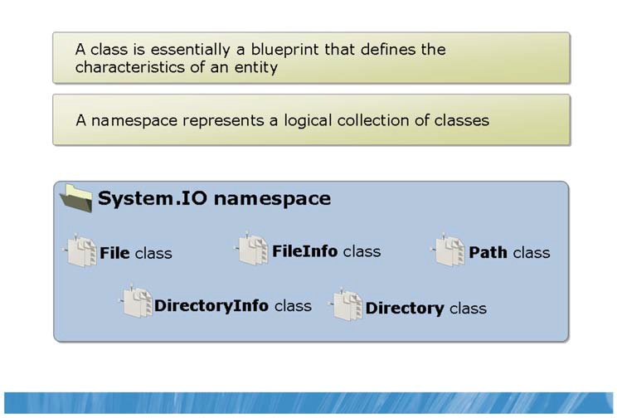
What Are Namespaces?

Slide 51
Namespaces
Namespaces are logical groupings of classes. The Visual Studio template code creates a namespace for each new project.
You may directly reference class and struct definitions within your own namespace.
All public classes of a namespace can be referenced in a separate class when the namespace is included with a using instruction at the top of the separate class file.

Slide 52
The ‘using’ Directive
Permits use of classes found in specific namespaces without having to qualify them
.NET Framework class library
Over 2,000 classes included
using System;

Slide 53
Namespaces
Demonstration: Namespaces

Slide 54
Partial Classes
By design, a default C# class must be declared in one file.
A partial class allows you to define your classes in more than one file.
Partial classes simplify code organization of large classes.

Slide 55
Partial classes
Partial classes are declared with the partial keyword just before the class keyword in the class declaration.
In a file named ClassName1.cs, the class declaration could look like the following:
public partial class ClassName { }

Slide 56
The Other File…
In another file, named ClassName2.cs, you could have the same class declaration to continue with the definition of the ClassName class:
public partial class ClassName { }

Slide 57
Partial Classes
Demonstration: Partial classes

